Slide 1
Navigating the Networks
Chantal Sunter
July 2014

Slide 2
Aims of today:
NIHR CRN Networks
a) Then, Now & the Future
b) Accessing Support
AcoRD Guidance & Costings
Questions

Slide 3
What is the NIHR CRN
NIHR Clinical Research Network (NIHR CRN) is the clinical research delivery arm of the NHS in England
NHS CRN provide support to several thousand studies in the NHS every year – a large proportion of the research that takes place

Slide 4
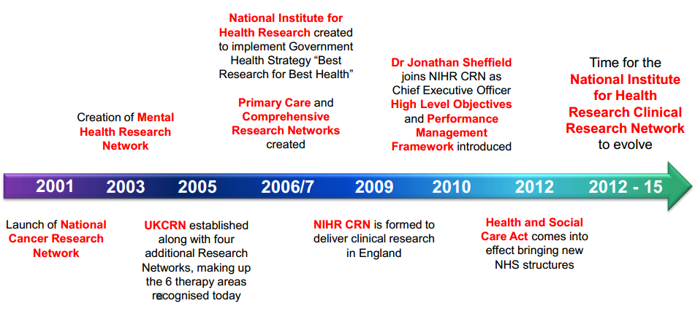
Journey so far…
NIHR Clinical Research Network (NIHR CRN) is the clinical research delivery arm of the NHS in England

Slide 5
Original Aims of the Networks
1 | Increase the number of high quality studies
2 | Increase the number of participants recruited to those studies (Double in 5 years)
3 | Support swift set up of studies including ID of additional sites
4 | Support recruitment into those studies by engaging clinical teams
5 | Ensure studies recruit to time and target
6 | Support PPI involvement
7 | Commercial studies

Slide 6
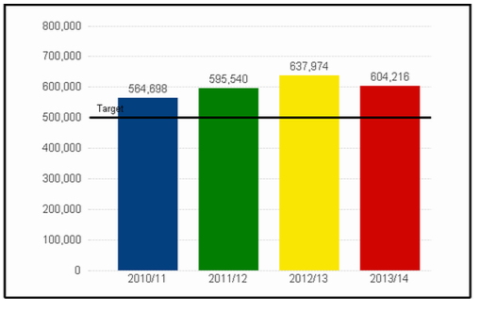
Patient Recruitment* (2013/14)
*England wide
Recruitment milestone
This is the fourth consecutive year that the Network has surpassed its target to recruit 500,000 patients per year to clinical studies
The Network has recruited more than three million patients to clinical studies in the last six years
Nearly 96,000 of these patients were recruited to commercial contract studies

Slide 7
NHS engagement
The proportion of research-active Trusts recruiting patients onto NIHR CRN Portfolio studies remains high at over 99%
The number of Trusts engaged in commercial contract clinical research is increasing year on year. 86% of Trusts now recruit patients onto NIHR CRN Portfolio commercial contract studies
Future challenge – Any Qualified Providers (AWP’s)

Slide 8
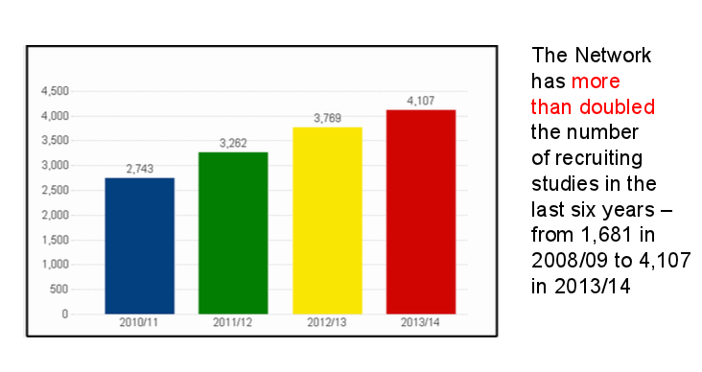
NIHR CRN Portfolio
2013/14 England wide

Slide 9
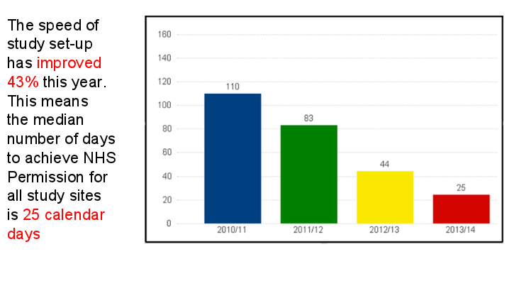
Study set-up
2013/14 England wide

Slide 10
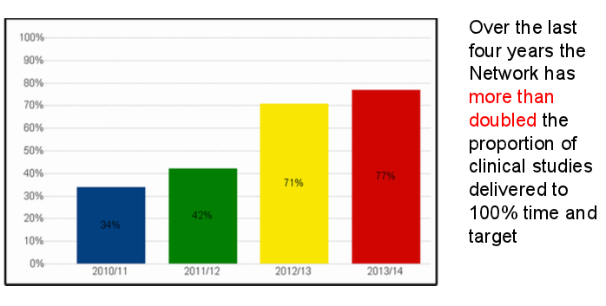
Study Delivery
2013/14 England wide

Slide 11
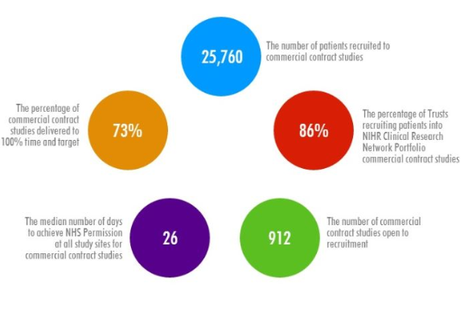
Supporting Industry
2013/14 England wide

Slide 12
Summary so far
Trends show that the environment for delivery of clinical studies in the NHS in England is improving
There is widespread engagement amongst healthcare providers
Patient recruitment is up
Study set-up times are down
The Network is not complacent – still driving performance improvements across all parts of the service
Inconsistent geographical coverage
102 local research networks → Duplication → increase in hosting costs, finance, HR etc
Inconsistencies in support available

Slide 13

Time for Change
Transition is a product of our success, it is important that we change to ensure we can continue to deliver clinical research to make patients, and the NHS, better
Evolution not Revolution

Slide 14
Why Transition?
Transition Programme Benefit
1 | Equality of access to research for patients
2 | Embedding of research into the new health and social care structures
3 | Enhanced engagement within the NHS and the life-sciences sector
4 | Increased efficiency through reduced transaction costs and increased productivity
5 | Transparent, consistent governance and clear accountability
6 | Improved flexibility and responsive research delivery
7 | Improved staff retention and career development

Slide 15
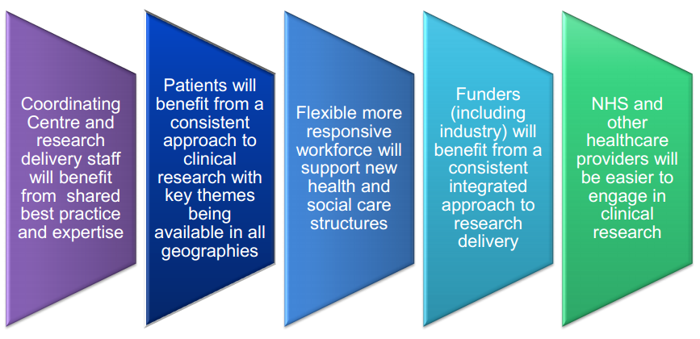
Benefits of Evolution

Slide 16
What Will Change?
 | Where are we now? | Where are we moving to?
Hosting | 9 NIHR CRN Network Coordinating Centres with 7 individual hosting agreements | 1 NIHR CRN Coordinating Centre (incorporating clinical thematic leadership) with 1 hosting agreement
 | 102 NIHR CRN comprehensive/local research networks with 102 individual hosting agreements with 70 hosts | 15 Local NIHR CRN research networks (integrated) with 14 individual hosting agreements with 14 hosts (ie, 1 each)
Geographical coverage | Inconsistent national coverage for research into key therapy areas | Full national coverage for research into all key therapy areas
 | Complex geographical configuration | Simplified geographical configuration
Resource coordination | Dispersed model of workforce coordination | Single model of workforce coordination, responsive to local need
 | Dispersed and fragmented oversight of deployment of resources | Strategic oversight for the deployment of resources at national / local partner level
 | Inconsistent models of funding allocation/use | Consistent models of funding allocation/use
Organisational structures | Complex organisational structure | Streamlined organisational structure
 | Inconsistent models of clinical leadership across networks | Consistent model of clinical leadership across networks
 | Partner organisations receiving multiple and confusing funding streams | Partner organisations receiving single coordinated funding stream

Slide 17

Integrating the Networks
2 x Cancer
1 x Mental Health
2 x Diabetes (partial coverage)
1 x Stroke (partial coverage)
1 x Primary Care
1 x Medicines for Children
1 x DeNDRoN
1 x CLRN

Slide 18
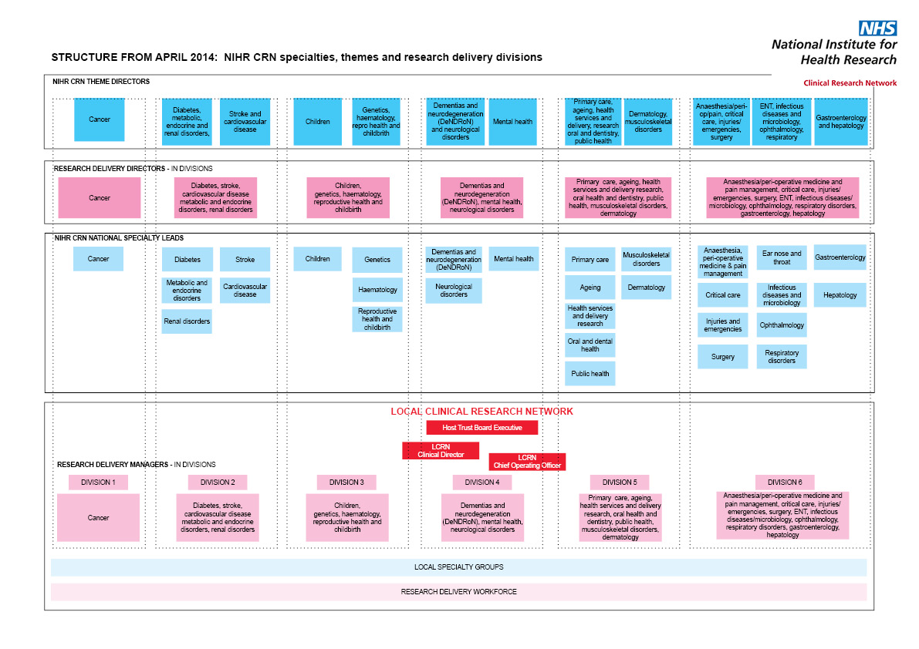
SPECIALTIES, THEMES & RESEARCH DELIVERY DIVISIONS:

Slide 19
CLINICAL DIVISIONS:
Division | Specialties in this division
1 | Cancer
2 | Diabetes, stroke, cardiovascular disease metabolic and endocrine disorders, renal disorders
3 | Children, genetics, haematology, reproductive health and childbirth
4 | Dementias and neurodegeneration (DeNDRoN), mental health, neurological disorders
5 | Primary care, ageing, health services and delivery research, oral health and dentistry, public health, musculoskeletal disorders, dermatology
6 | Anaesthesia/peri-operative medicine and pain management, critical care, injuries/emergencies, surgery, ENT, infectious diseases/microbiology, opthalmology, respiratory disorders, gastroenterology, hepatology

Slide 20
Management & Leadership Structure
Clinical Director
(Dr Stephen Falk)
Chief Operating
Officer
(Dr Mary Perkins)
Nurse Consultant
(Dr Sue Taylor)
Senior Research Delivery
Manager – Cross Cutting
(Martine Cross)
Senior Research
Delivery Manager:
(Maxine Taylor, Div 1&3)
Industry Operations
Manager
(Acting - Holly Valance)
LCRN Research
Delivery Cross –
Cutting Team
Research Delivery
Manager
(TBA - Div 2&4)
Research Delivery
Manager
(Chantal Sunter,
Div 4&5)

Slide 21
Research Delivery Divisions:
Operational delivery of the LCRN portfolio managed through six nationally determined research delivery divisions, each encompassing a number of specialties
Managed by a Research Delivery Manager, each Manager will form national networks of operational expertise, led nationally by a Research Delivery Director for the Division
LCRN Research Delivery Managers will report to the LCRN Chief Operating Officer and be responsible for the delivery of NIHR CRN portfolio studies

Slide 22
LCRN Support Team:
The LCRN will have a Support Team to manage local operational arrangements. This team will be required to support and deliver the following functions and systems:
  Support functions including (some of these functions may be encompassed within research delivery roles):
    LCRN administration
    Information management
    Workforce development
    Communications
    Patient carer and public involvement and engagement
    Finance
  CRN systems, including information systems (for example, the CSP Module for NHS Permissions, CPMS and LPMS)

Slide 23
Research Delivery
Cross-Divisional Team
Research Delivery Cross-Divisional Team will undertake delivery activities that support all clinical specialties. Activities will include the provision of:
  A LCRN research advice service
  A single point of contact service for Life Sciences Industry
  A Lead LCRN service and Coordinated Network Support service, in-line with national standards
  The NIHR Coordinated system for gaining NHS Permission (CSP)
  Coordination of the Research Passport Scheme

Slide 24
What is staying the same?
Evolution not revolution
Delivery staff (Research Nurses, Clinical Studies Officers)
Fewer issues around crossing boundaries e.g. mental health staff working in primary care settings or AHP’s on mental health related studies
Contact your relevant RDM or usual Lead Research Nurse / Senior CSO if looking for study support
RDM’s working closely with R&D offices across the region
Involve the network at early stage as possible

Slide 25
Patient and Public Involvement
PPI / PI / PCPIE / Service User Involvement
Cross organisation approach and team
Retaining specialty groups where appropriate
ClahrcWest / WEAHSN / CRN WE / HPU
Strategy group:
8 public members (2 sit on each organisation)
4 organisational members
Develop and agree strategies on common issues e.g. payment

Slide 26
PPI (Division 4)
Currently still a dedicated PPI worker 0.4wte
Some initiatives looking to roll out across specialties:
  Pre-ethics materials review service
  Exit questionnaire
  Everyone Included

Slide 27
AcoRD
Attribution of COsts of Research & Development
Formerly known as ARCO
Major aim to
Improve the consistency of cost attribution
Encourage more consistent funding of the costs of research
(Research Costs, Excess Treatment Costs, Service Support Costs)

Slide 28
Major Changes
Guidance aims to clarify / correctly attribute R&D costs to either ETC, SSC or research costs
ARCO classified on the basis of WHO was carrying out the activity
AcoRD classifies on the basis of the PRIMARY PURPOSE of the activity.
Pilot of a new Costing template ACAT (Activity Capture Attribution Template) for use with full grant applications
Taking consent is classified as SSC not research cost
2 different categories of research costs (Depends on funder)

Slide 29
AcoRD continued
Network Delivery Funding is Service Support Costs = early engagement important
Currently will primarily impact AMRC funders (even when only part of the grant funding is from AMRC)
Full application stage will require ACAT completion with the application (funders will inform applicants if / when required)
Likely to be rolled out to all funders eventually

Slide 30
ACAT support
AcoRD Specialists in each Clinical Research Network
You will be informed if you are required to complete the ACAT and who your local specialists are.
They will provide support in completing the ACAT (but wont complete it for you)
The completed ACAT will then be reviewed by additional ACAT reviewers following submission to funder
Suite of support materials available at
http://www.crn.nihr.ac.uk/can-help/funders-academics/support-for-non-commercial-studies/acord/

Slide 31
Thank you for listening
Questions?
Chantal.sunter@nihr.ac.uk

